Slide 1
New City?
Wanna find an address?
But frustrated following that blue dot on Google Maps?

Slide 2
Home Finder AR
Team Name : Code Seeker
Team Lead : Ankit Gautam
Team Member : Yash Joshi
Team Member : Arunam Goyal(LNMIIT student)
College : Sri Aurobindo Institute of Technology, Indore

Slide 3
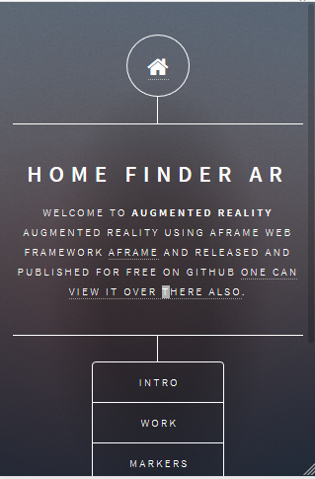
Home Finder AR
A MOBILE RESPONSIVE WEB-APPLICATION.
THAT ENABLE USER TO FIND OTHERS HOME AS WELL AS REGISTER TO GET YOUR HOME FOUND.

Slide 4
Existing Systems
There is no such system available, However Google in Google I/O 2018 launched Google Maps AR which uses Augmented reality, camera and image/video processing to guide people with the correct streets rather than letting them follow that blue dot on the prior Google Map.

Slide 5
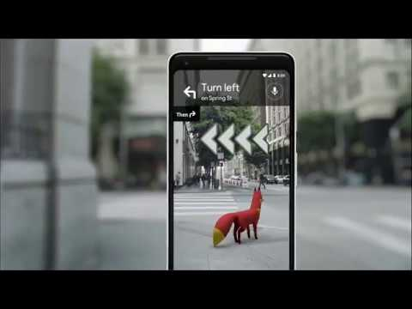

Slide 6
How we started?
Created Mobile Responsive Web-App.
Used Python(CGI) for data handling.
Downloaded AR.js (aframe framework).
Used and provided AR marker training tool to users.
Allowed users to find the details behind the markers by running Home Finder AR.
…...Finally crawled back to our web-app with AR.

Slide 7
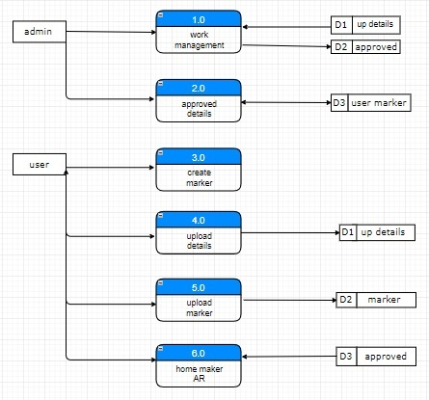
Architecture
User interface
Admin interface

Slide 8
Our System Till Today….
Our system mainly focuses on data wrangling that how we can decrease the load of image/video processing, that’s why we are using marker’s recognition in place of image/video processing. User have to create marker and along with this marker(.patt) file, user have to register there. Even user can delete his marker or details using his/her email address along with the passkey provided after approval of his/her details.

Slide 9
Milestones to reach….
User can add paying guests details.
User can advertise something(Small/household businesses).
If there is some space available for rent(one can directly ping with a button click).
User can modify his/her as well as paying guest details.

Slide 10
Domains where same concept could be used :
01
Schools or College : one can find the previous, next and ongoing lecture details along with the faculty details.
02
Safety & security : The same marker can be pasted on the bag or nails of childs one can find them easily as they get lost somewhere.
03
Traffic System : Every heavy vehicle should paste some marker whose details could be altered and traffic camera can detect that what these heavy vehicle are carrying.
04
Bus System: Acknowledging the bus route that what all bus stop it will cover and at what accurate time.(implemented in our web-app).

Slide 11
Technology Stack
Front End
HTML & CSS.
JS, JQuery, Bootstrap.
Back End
Python.
MySQL(Database)
AR.js
ML for AR marker training tool.
Frameworks
Aframe(Web Framework) .

Slide 12
Thanks for being with us!!!
Any Questions???

